Slide 1
Lighter & Faster Semantic Segmentation by Post-Training Quantization & Quantization-Aware Training
SJSU CS 256 GroupE
Anand Vishwakarma, Inhee Park, Sagar Shahi, Sherif Elsaid, Sriram Priyatham

Slide 2
overview

Slide 3
Computer Vision Topic -- Semantic Segmentation
=> Hard problem: object detection + multi-classification at pixel level
Segmentation Framework -- DeepLabV3+
=> Atrous convolution (faster), Encoder-Decoder (shaper boundary)
Backbone Architecture -- MobileNetV2
=> Depthwise-separable-convolution + Inverted-Residual-Layer; TFLite for Mobile & IoT
Project Task -- Quantization
=> Quantization makes DeepLabV3+ on MobileNetV2 more lighter and faster
Quantization Approach 1 -- Post-Training-Quantization => F32 model prep -> Quantize
Quantization Approach 2 -- Quantization-Aware-Training => F32 model prep -> Quantize
Inference and Evaluation with Demo (Quantization & Inference Script on Colab)
=> Comparison between F32 vs. 8-bit integer inferences

Slide 4
Computer Vision Topic -- Semantic Segmentation
=> Hard problem: object detection + multi-classification at pixel level

Slide 5
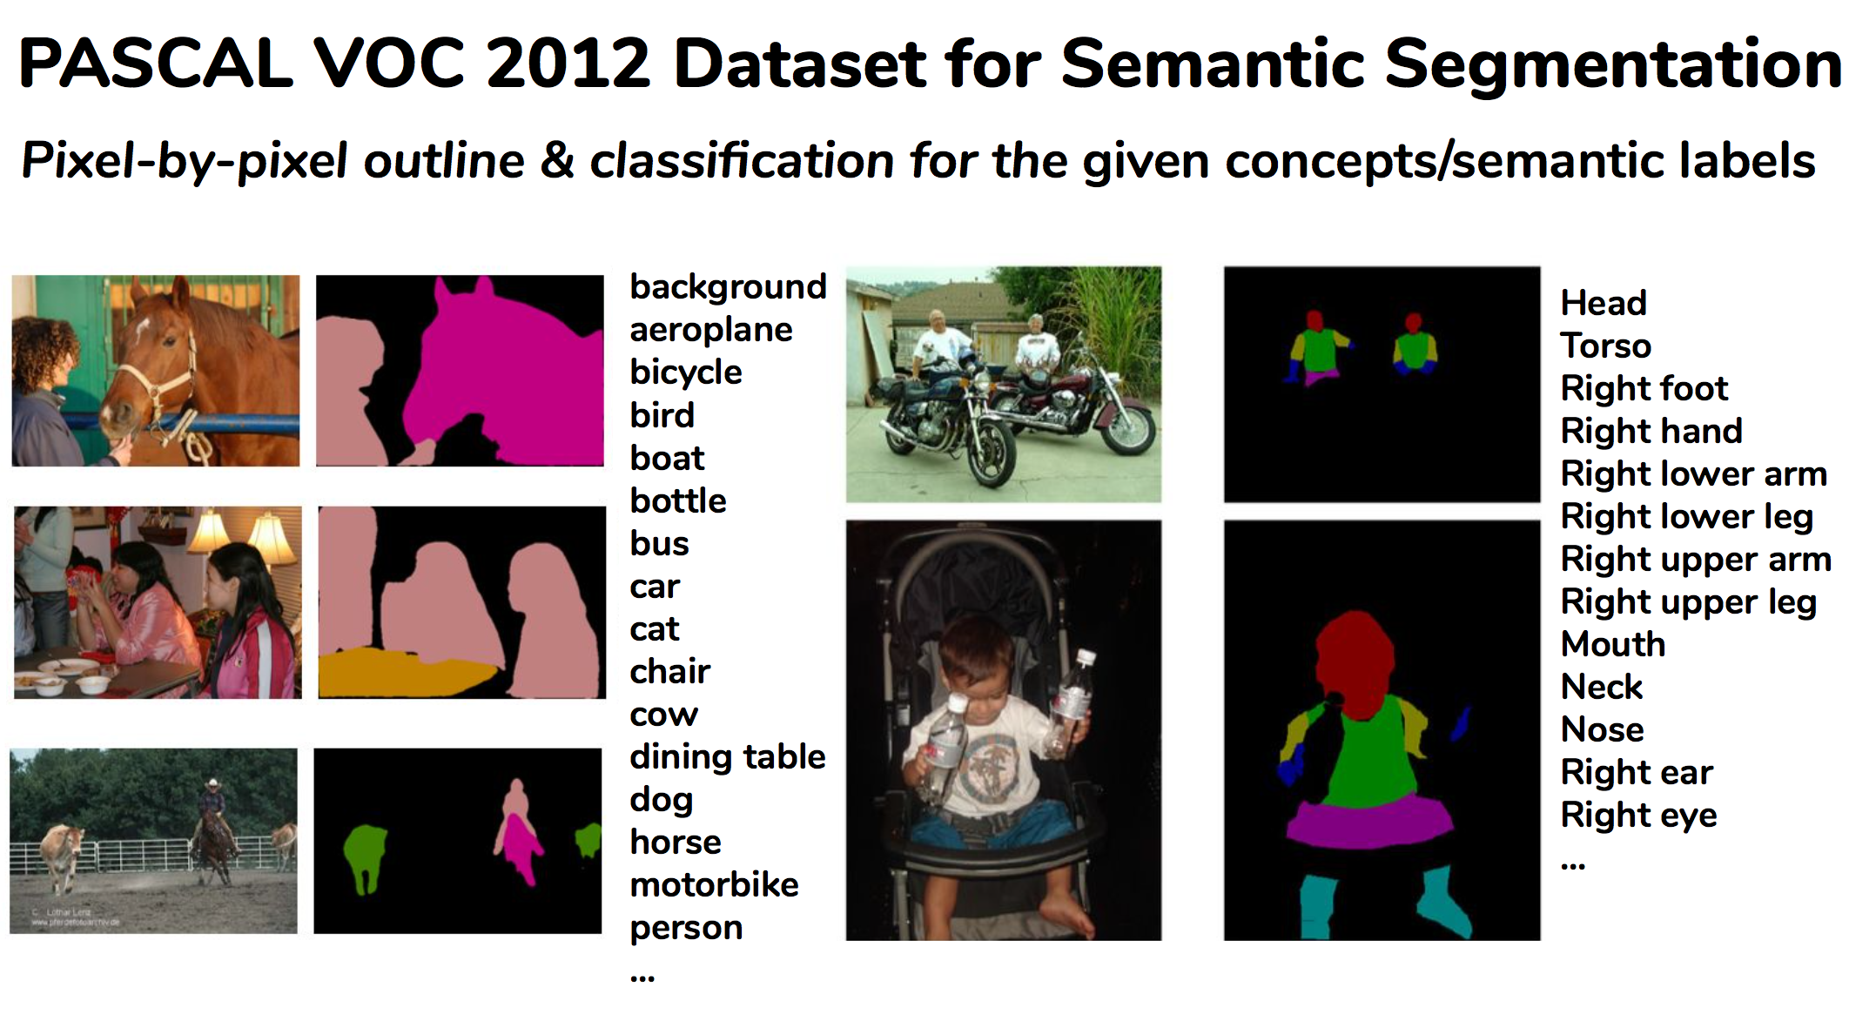
Semantic Segmentation Requires
1) pinpointing the outline of objects;
2) imposing much stricter localization accuracy than image-level classification

Slide 6
2. Segmentation Framework -- DeepLabV3+
=> Atrous convolution (faster), Encoder-Decoder (shaper feature extraction)

Slide 7
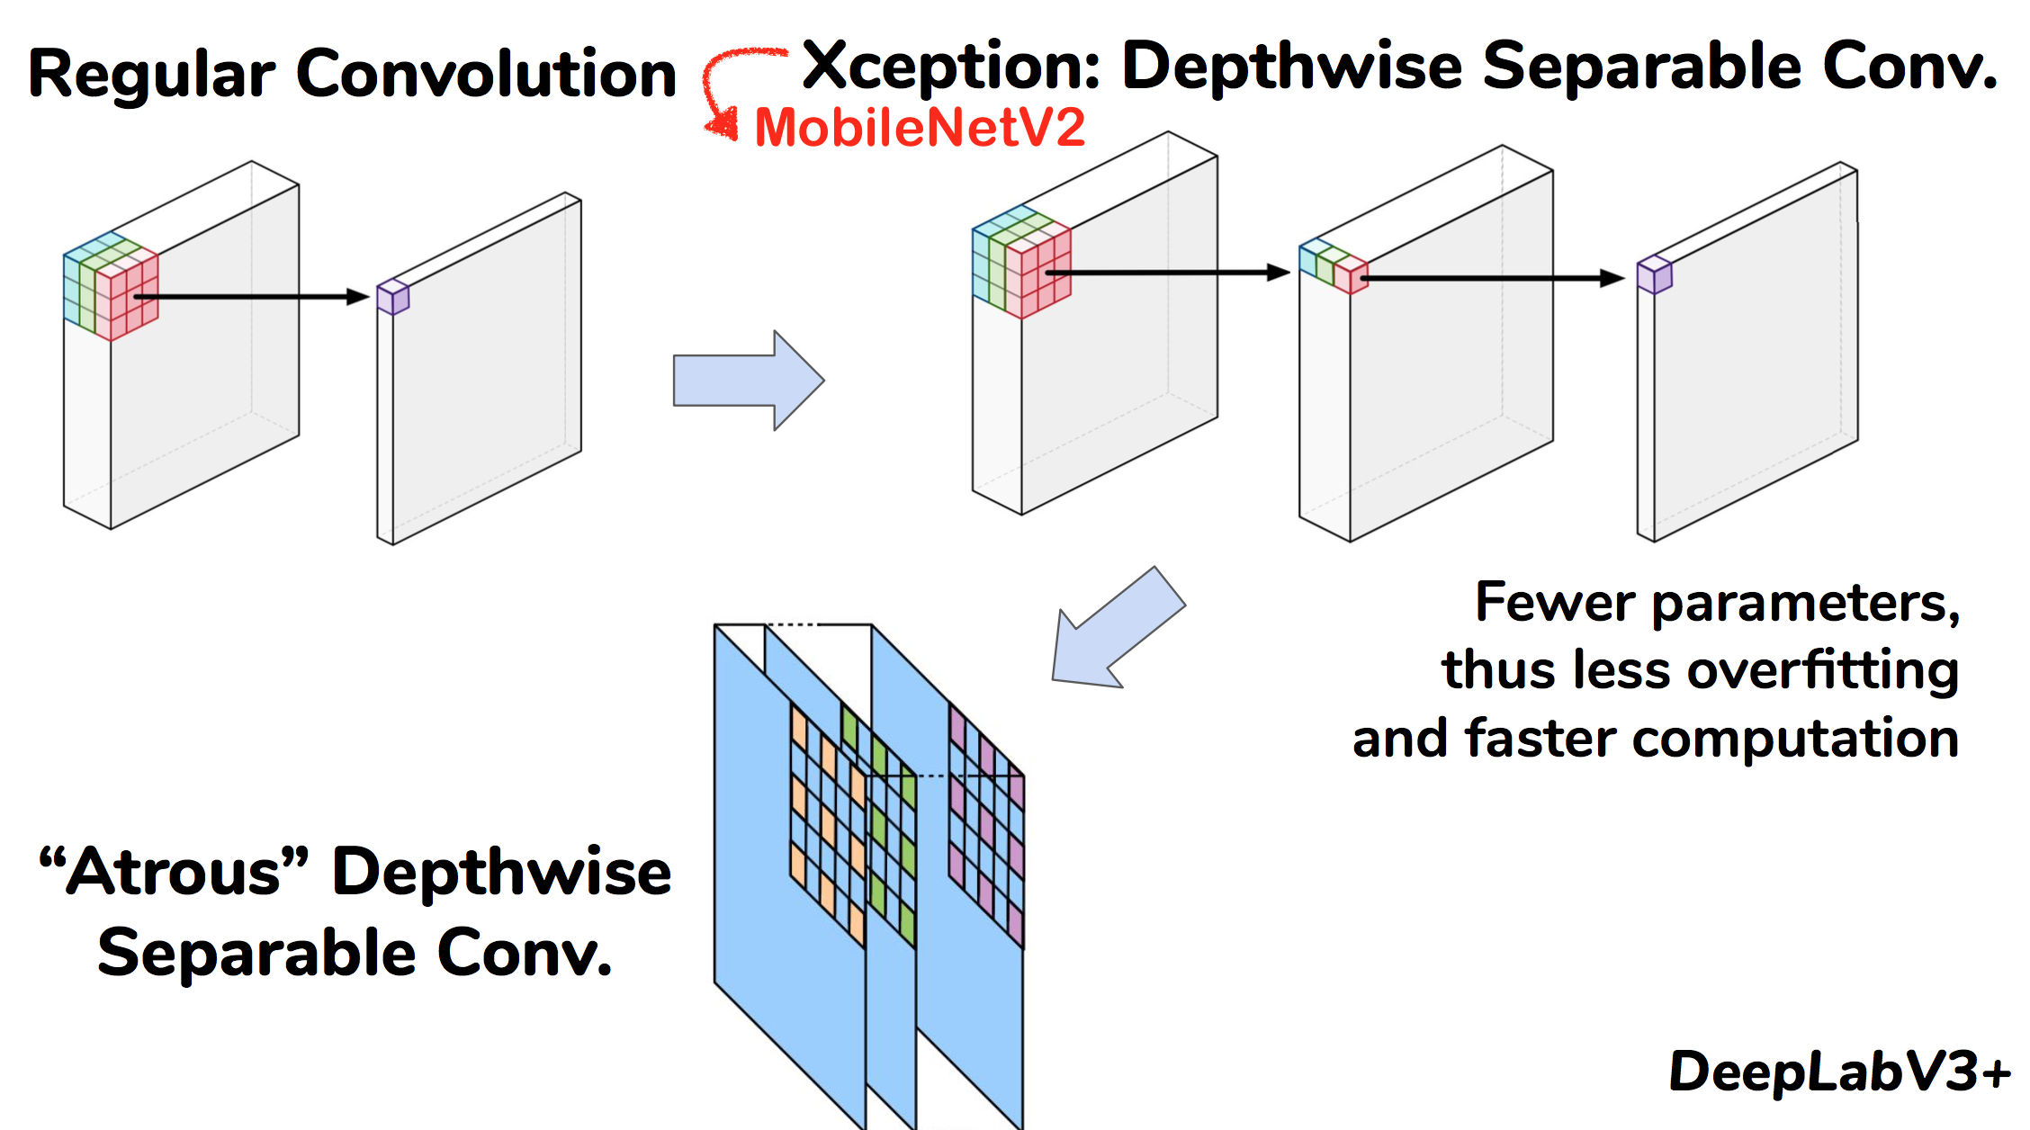
DeepLabV3+: Faster “Atrous Depthwise Separable” Conv. on MobileNetV2

Slide 8
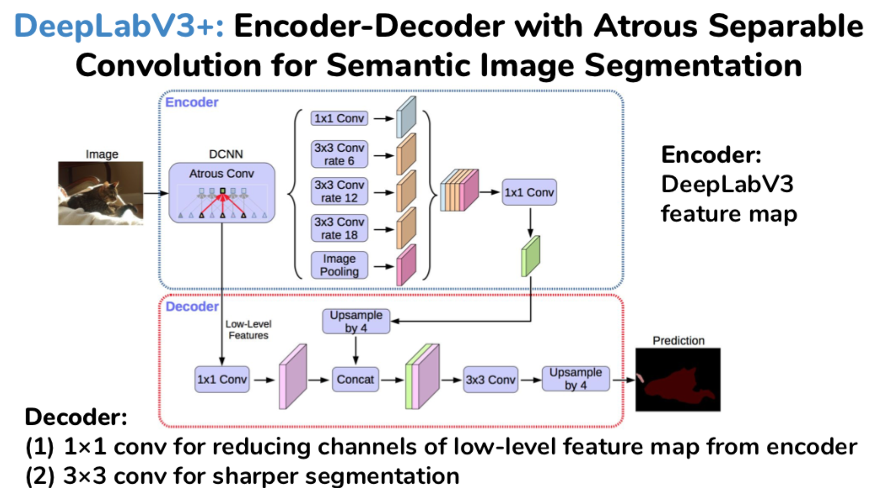
DeepLabV3+: Sharper Boundary Segmentation by Encoder-Decoder

Slide 9
3. Backbone Architecture -- MobileNetV2
=> Depthwise-separable-convolution + Inverted-Residual-Layer; TFLite for Mobile & IoT

Slide 10
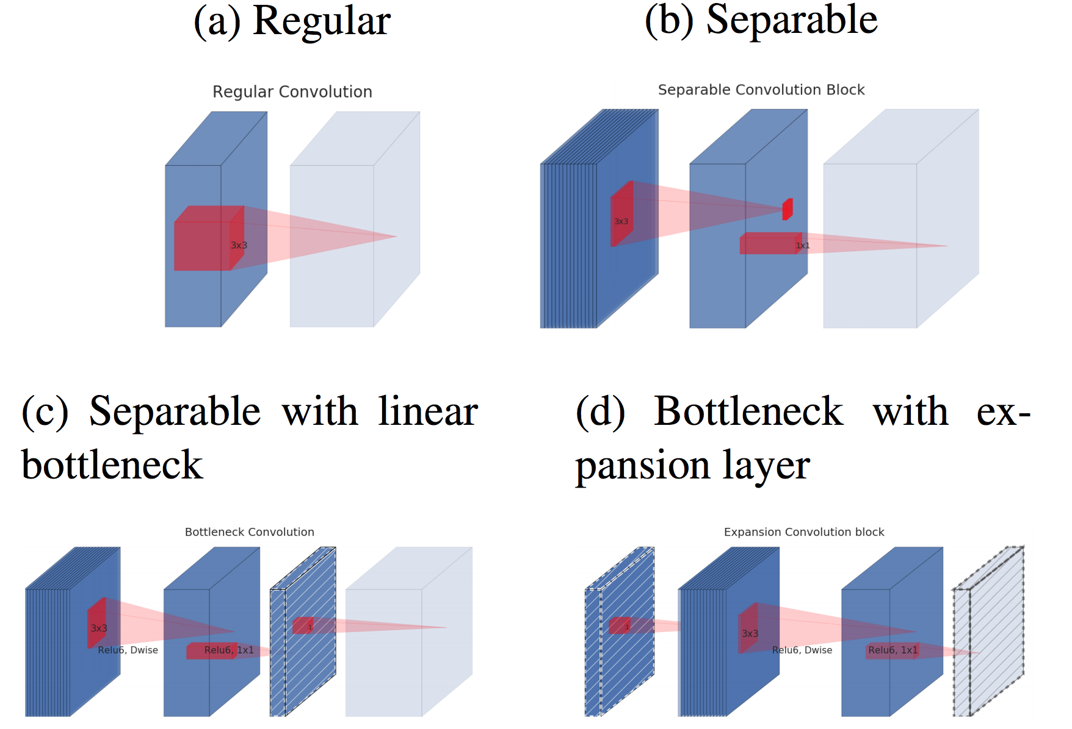
MobileNetV2: Depthwise-Separable-Conv + Inverted-Residual Layer

Slide 11
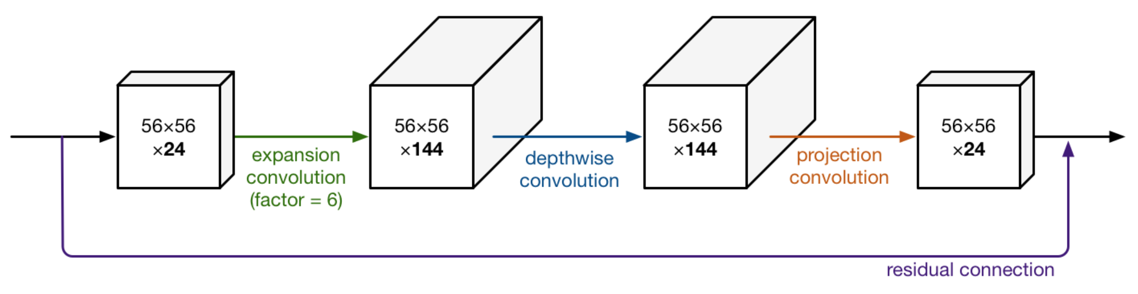
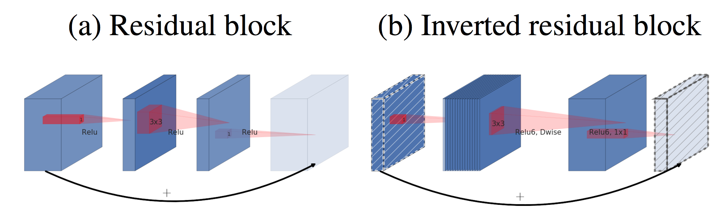
MobileNetV2:
1) Depthwise-Separable-Conv
Like DeepLabV3+
2) Inverted-Residual Layer
Like ResNet but Expansion

Slide 12
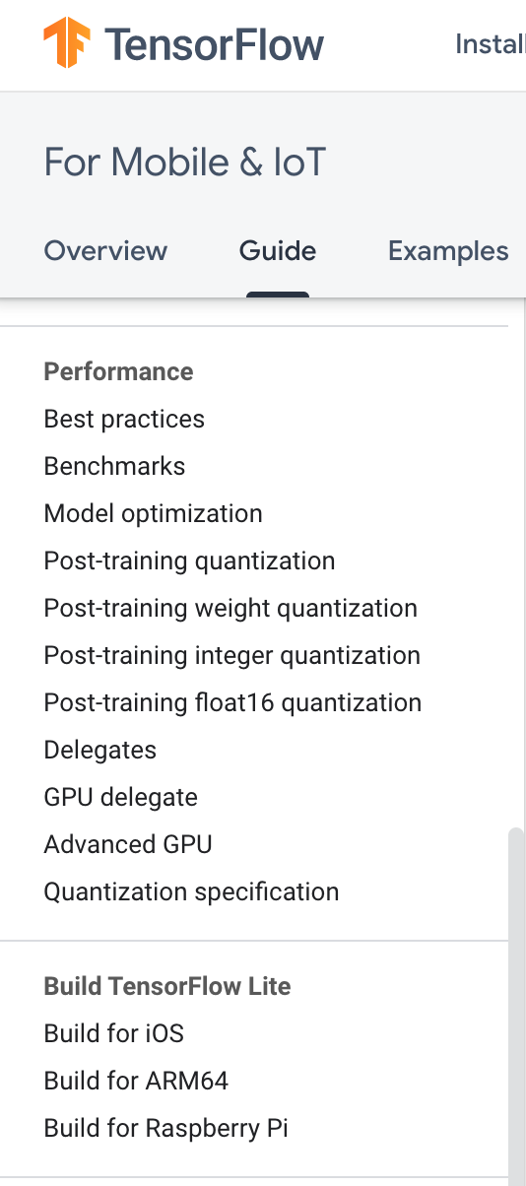
MobileNetV2
using TensorFlow Lite for
Mobile & IoT

Slide 13
4. Project Task -- Quantization
=> Quantization makes DeepLabV3+ on MobileNetV2 more lighter and faster

Slide 14
Fixed point Fake quantization implemented in TensorFlow
First find the range of values in our tensor. The range we use is always centered on 0, so we find m such that
m = max(abs(input_min), abs(input_max))
Our input tensor range is then [-m, m]
Next, we choose our fixed-point quantization buckets, [min_fixed, max_fixed].
With input tensor T, num_bits = sizeof(T) * 8
If T is unsigned, the fixed-point range is
[min_fixed, max_fixed] = [0, 2^(num_bits) - 1]
From this we compute our scaling factor,
s = (max_fixed - min_fixed) / (2 * m)
Now we can quantize the elements of our tensor
result = round(input * s)

Slide 15
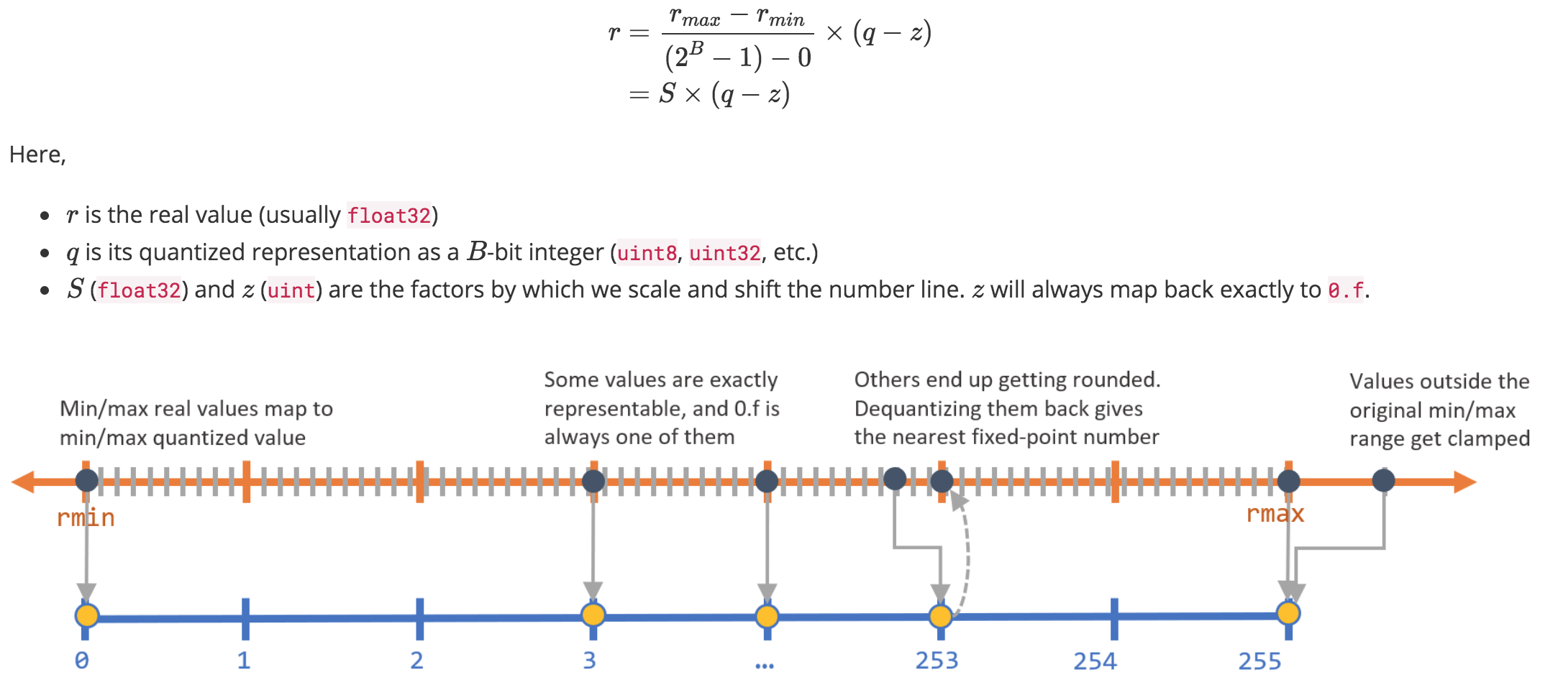
Fixed point Fake quantization implemented in TensorFlow

Slide 16
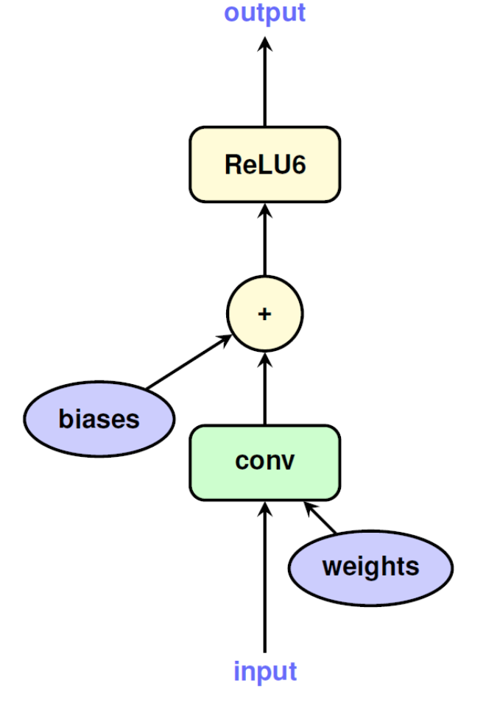
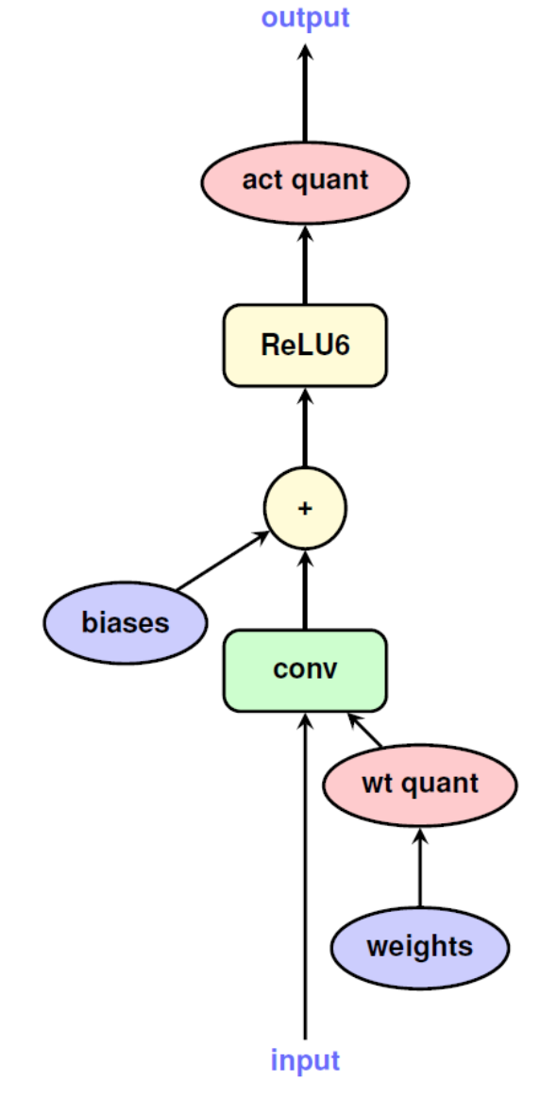
Fixed point Fake quantization implemented in TensorFlow

Slide 17
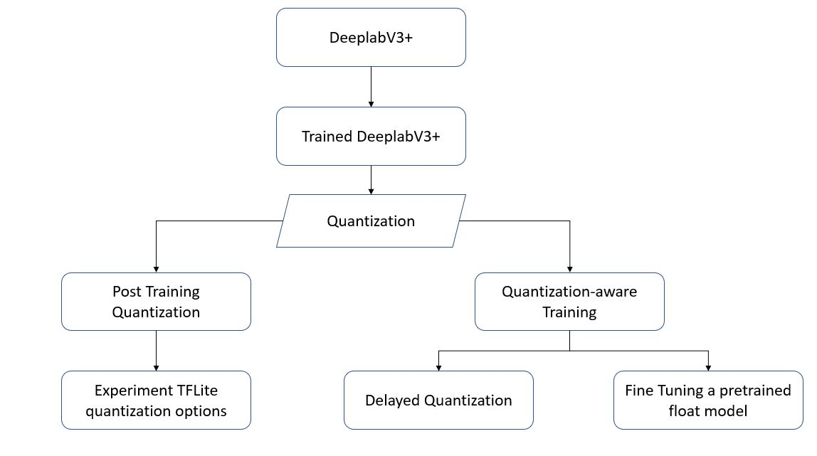
Quantization Experiments

Slide 18
5. Quantization Approach 1 --
Post-Training-Quantization
=> F32 model prep -> Quantize

Slide 19
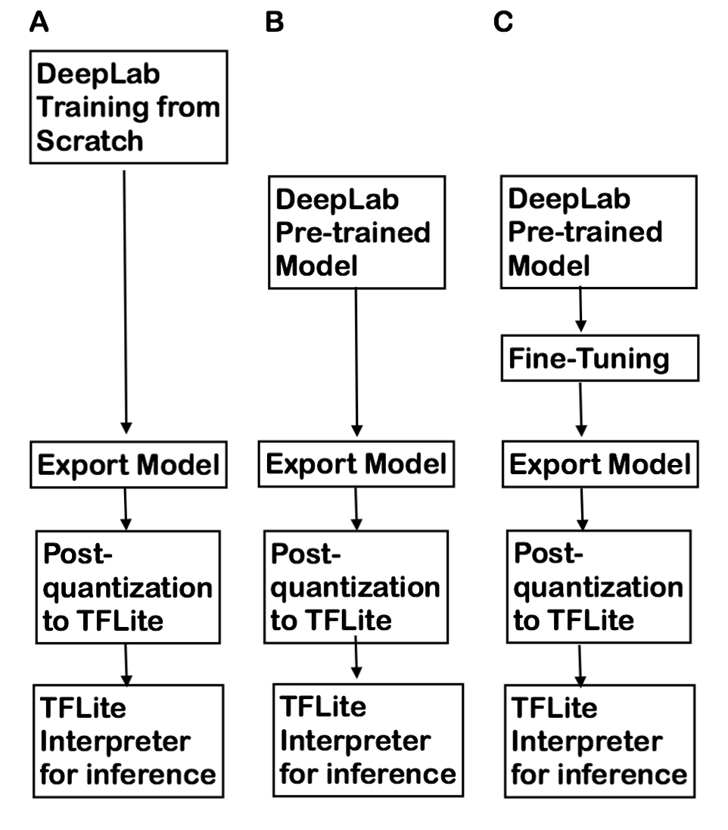
Post-Training-Quantization
WorkFlow
Train from scratch
No Fine-tuning
Fine-tuning
w/ 1, 10, 100, 1K, 10K iterations

Slide 20
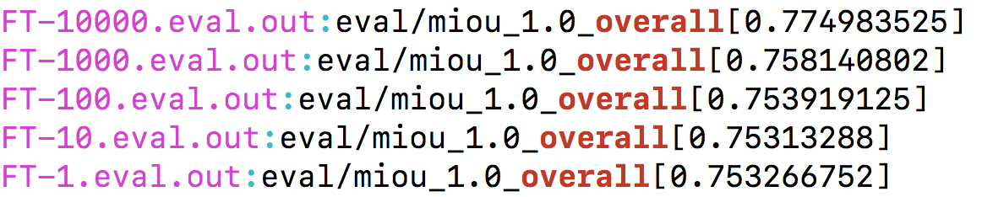
Prep for Full 32-bit Float Models for Post-Quantization
Train from scratch mIOU 3.4% w/ PASCAL dataset; must need extra COCO augmented dataset
Overall mIOU improves as increase of iterations of Fine-Tuning FT)

Slide 21
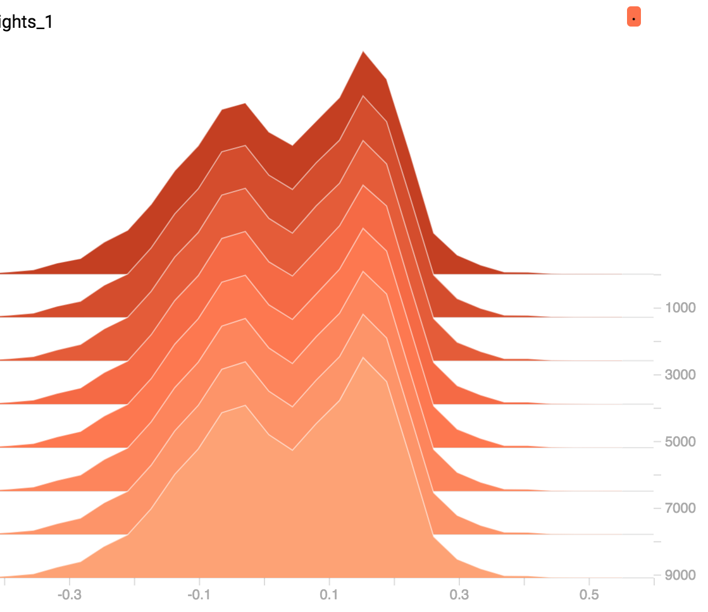
Logit Weights Distribution from Fine-Tuning (32-bit model)
32-bit Float range --> quantized 8-bit integer

Slide 22
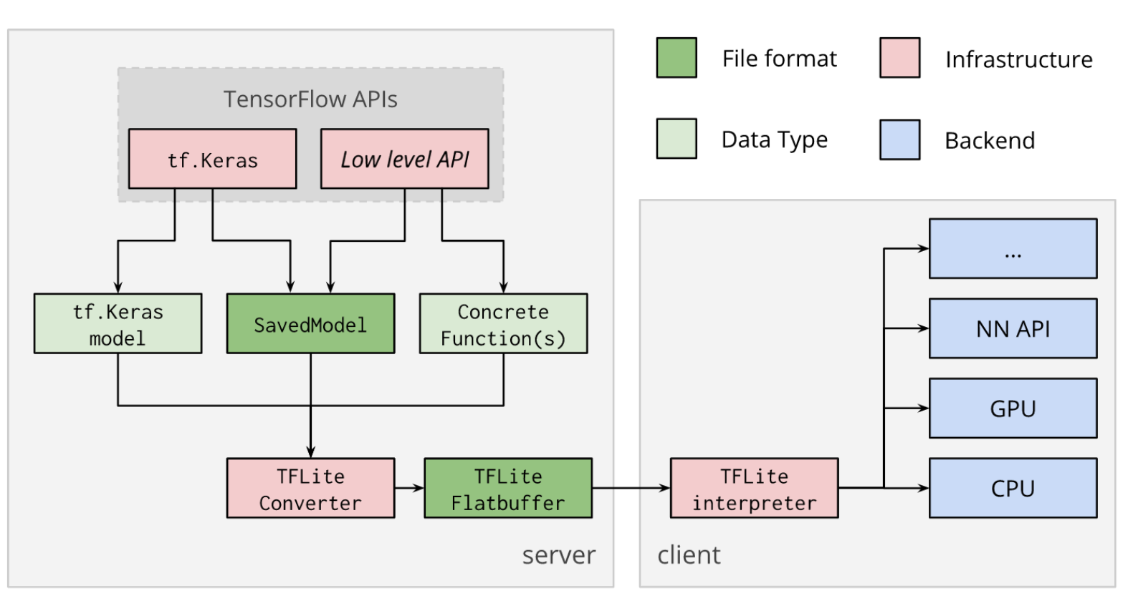
Quantization with TFLite (chehckpoints vs. SavedModel)

Slide 23
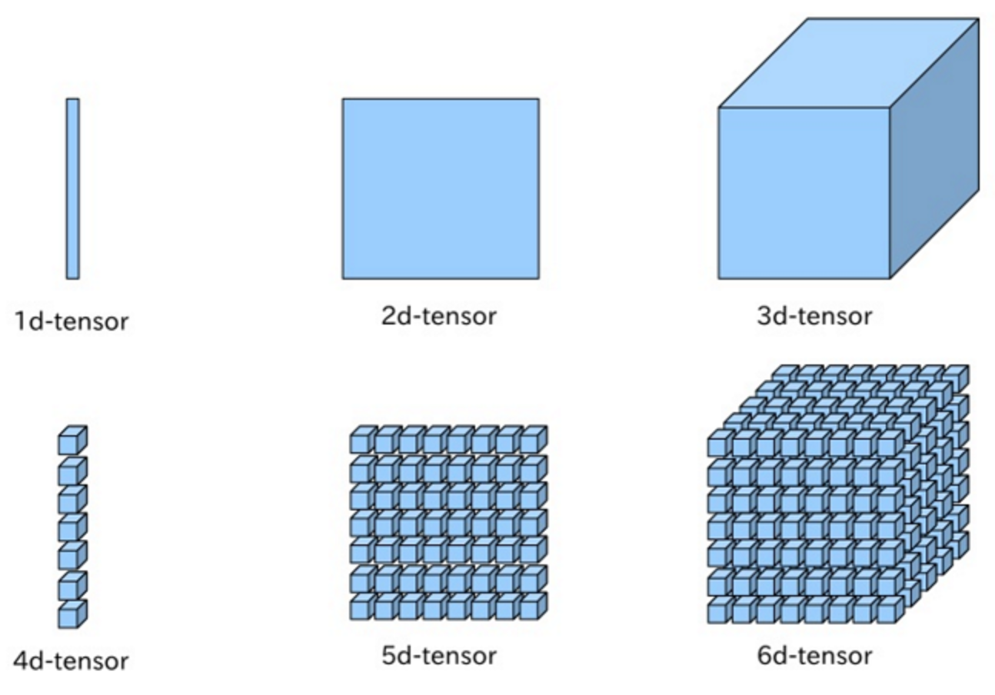
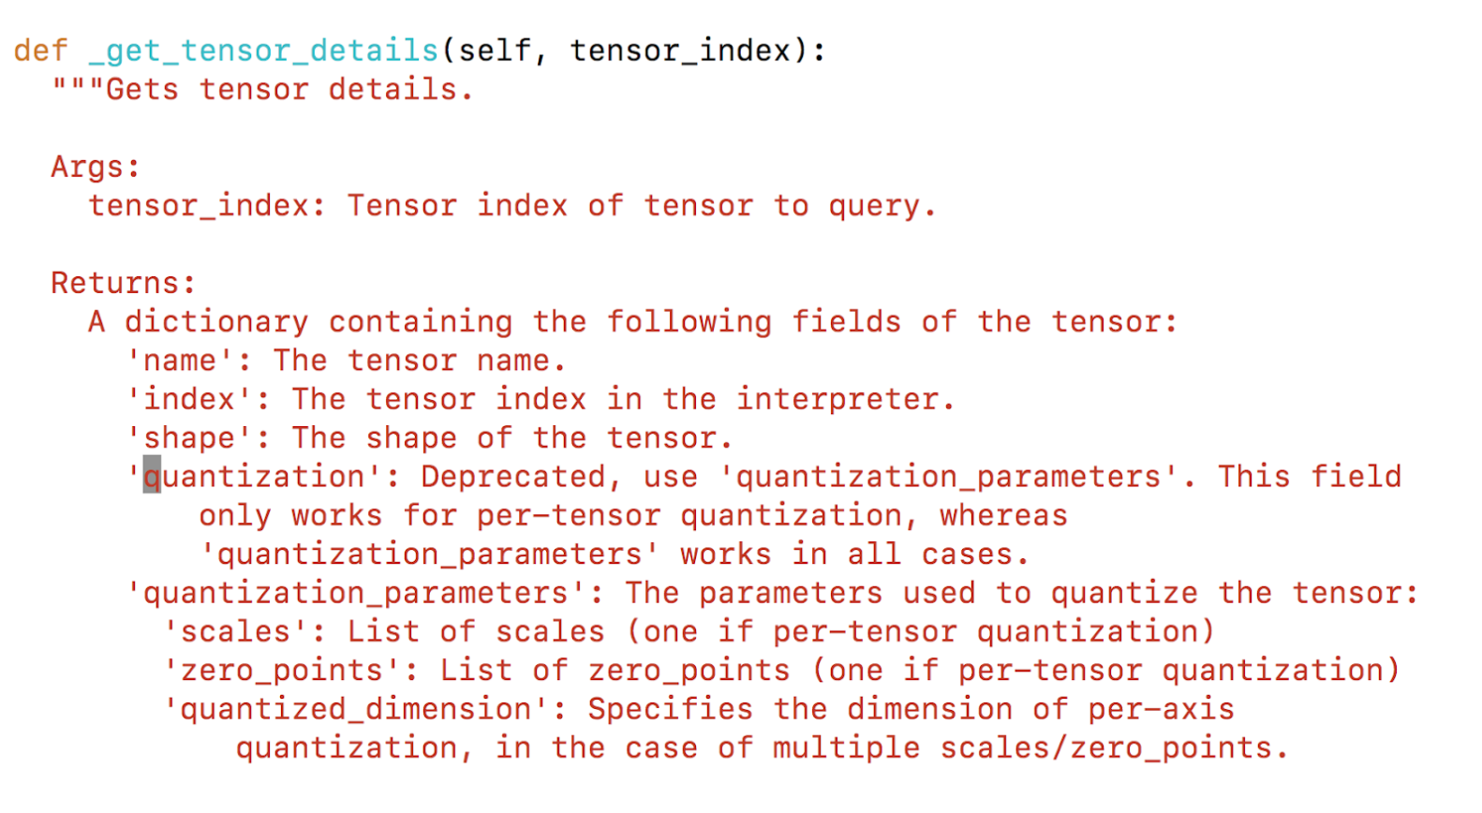
Per-Tensor Quantization {‘quantization’: scales, zero_points}

Slide 24
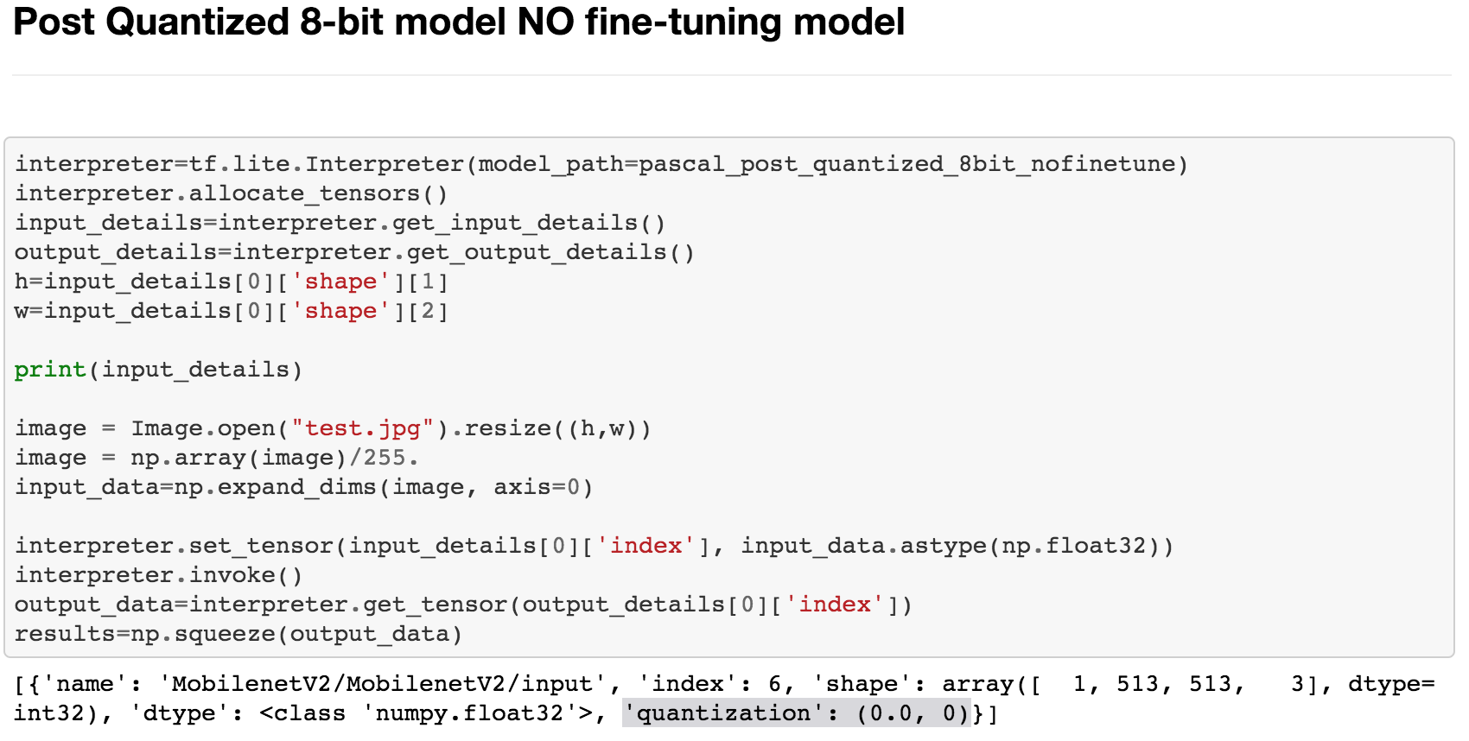
Post-Quantization {‘quantization’: (scales, zero_points)=(0.0, 0)}

Slide 25
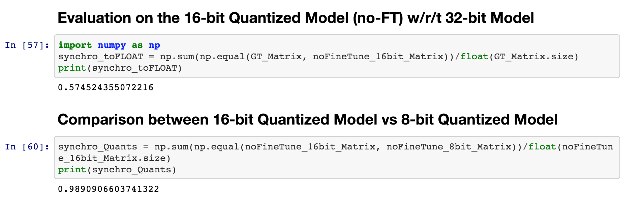
Post-Quantization Results

Slide 26
6. Quantization Approach 2 -- Quantization-Aware-Training
=> F32 model prep -> Quantize

Slide 27
Quantization Aware Training : Pretrained Model
Pre Trained
DeepLab V3 Model
Without Quantization
Fine Tuning
Train with learning rate 3e-5

Slide 28
Quantization Aware Training : Pretrained Model
Pre Trained
DeepLab V3 Model
Without Quantization
Fine Tuning
Train with learning rate 3e-5
python deeplab/train.py
--base_learning_rate=3e-5
--training_number_of_steps=3000
--tf_initial_checkpoint=${PATH_TO_TRAINED_FLOAT_MODEL}

Slide 29
Quantization Aware Training : Pretrained Model
Pre Trained
DeepLab V3 Model
Without Quantization
Fine Tuning
Train with learning rate 3e-5
Export model
frozen_infernece_graph.pb

Slide 30
# From tensorflow/models/research/
python deeplab/export_model.py \
--checkpoint_path=${CHECKPOINT_PATH} \
--quantize_delay_step=0 \
--export_path=${OUTPUT_DIR}/frozen_inference_graph.pb

Slide 31
Quantization Aware Training : Pretrained Model
Pre Trained
DeepLab V3 Model
Without Quantization
Fine Tuning
Train with learning rate 3e-5
Export model
frozen_infernece_graph.pb
Convert to TFLite
frozen_infernece_graph.tflite

Slide 32
tflite_convert \
--graph_def_file=${OUTPUT_DIR}/frozen_inference_graph.pb \
--output_file=${OUTPUT_DIR}/frozen_inference_graph_quant.tflite \
--output_format=TFLITE \
--inference_type=QUANTIZED_UINT8 \
--inference_input_type=QUANTIZED_UINT8 \

Slide 33
Quantization Aware Training : Pretrained Model
Pre Trained
DeepLab V3 Model
Without Quantization
Fine Tuning
Train with learning rate 3e-5
Export model
frozen_infernece_graph.pb
Convert to TFLite
frozen_inference_graph.tflite
Run Inference on TFLite

Slide 34
Quantization Aware Training : Pretrained Model
Model Size:
Non Quantized | Quantized
8.6 Mb | 2.1 Mb

Slide 35
How is the Quantization Aware Training Performed?
Parameter to the training script “--quantize_delay_step”
To create tf.contrib.create_training_graph()
Used to train models for quantization..

Slide 36
Delayed Quantization
One of the .Next items that we showcased for the final milestone
Used when training and quantization have to be performed in the same cycle.
Quantization will be delayed until the last few steps.
Controlled by the argument ‘quant_delay’ for the function tf.contrib.create_training_graph()

Slide 37
Delayed Quantization
Trained a DeeplapV3+ model from scratch with the following parameters
python train.py
--training_number_of_steps=36000
--quantize_delay_step=30000
--base_learning_rate=0.0001

Slide 38
7. Inference and Evaluation with
Demo (Quantization/Inference)
=> Comparison between F32 vs. 8-bit integer inferences

Slide 39
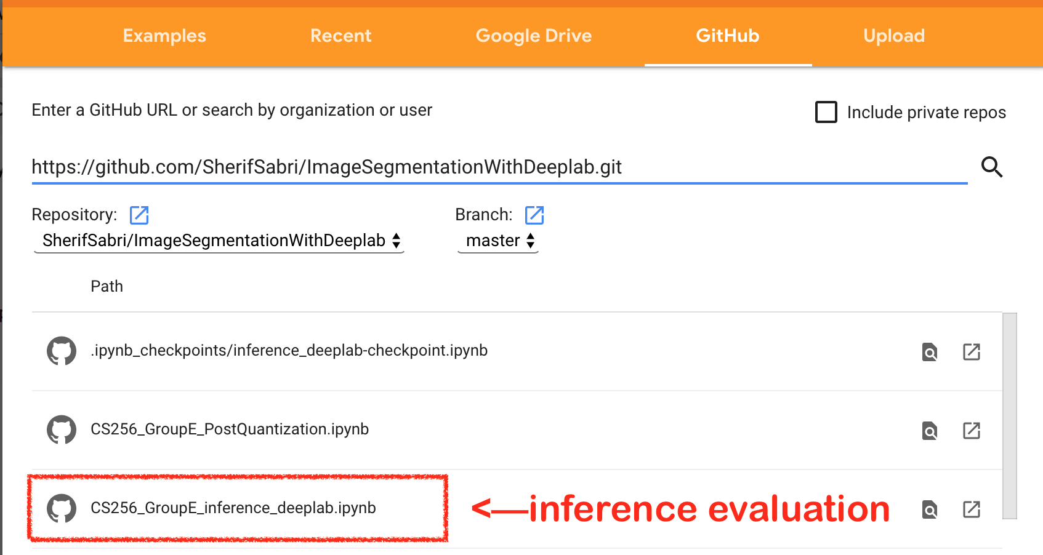
Demo on the Colab by Searching our GitHub
https://github.com/SherifSabri/ImageSegmentationWithDeeplab
CS256-GroupE_inference_deeplab.ipynb

Slide 40
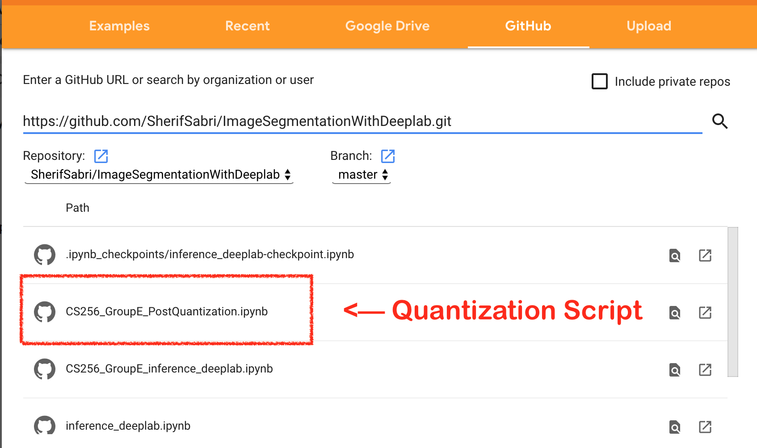
Post-Training Quantization Script is available
https://github.com/SherifSabri/ImageSegmentationWithDeeplab
CS256-GroupE_PostQuantization.ipynb

Slide 41
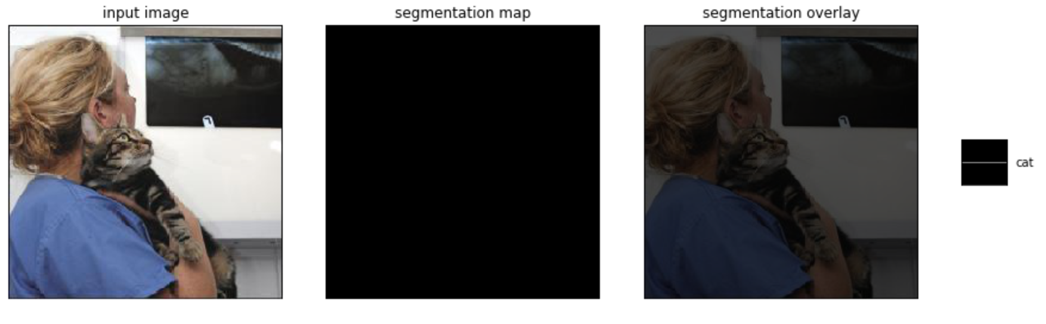
Initial Results
Failed to produce segmentation mask, and an invalid quantization field

Slide 42
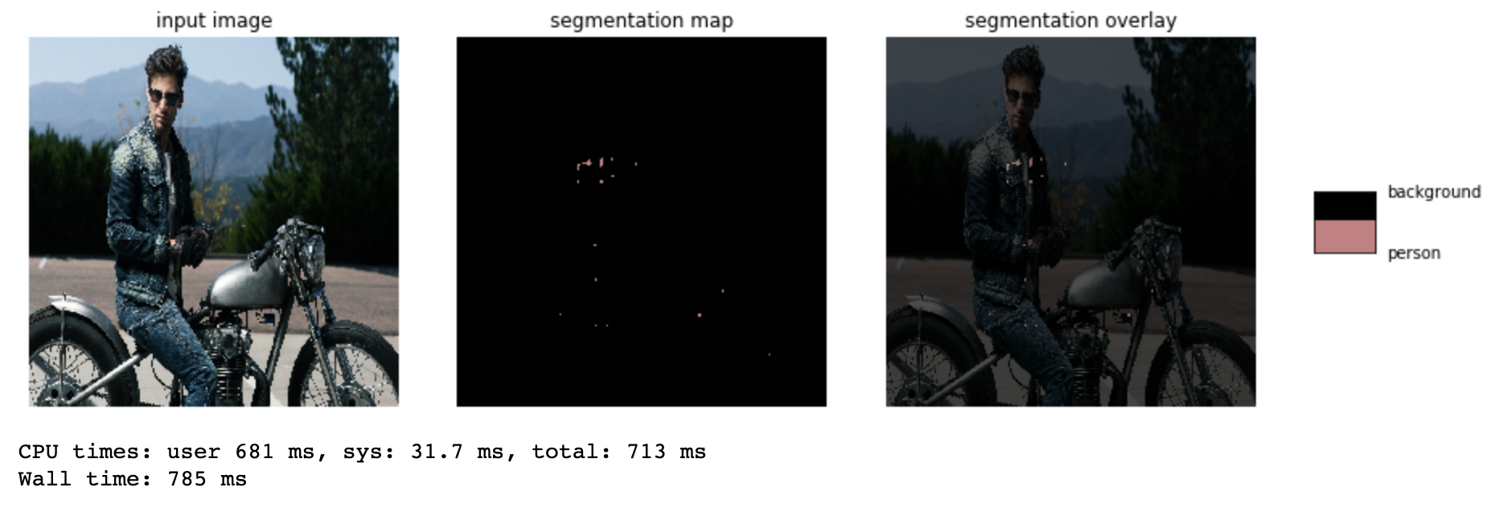
Initial Results
Still Failed to produce segmentation mask, with a valid quantization field

Slide 43
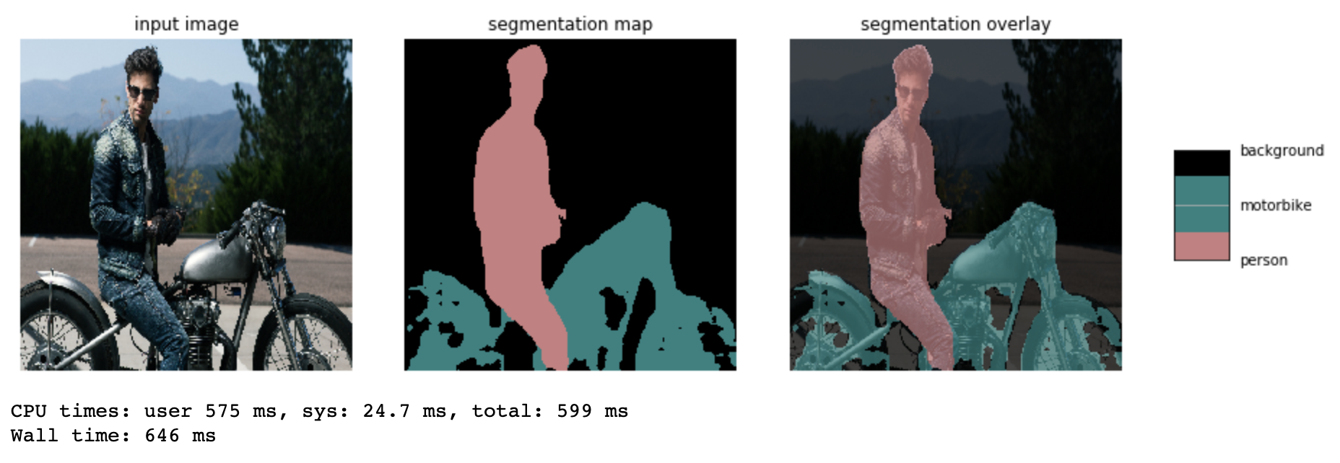
Final Results
Successful inference on quantized model

Slide 44

Comparison with Deeplab authors provided model
Comparable results both in accuracy and inference time

Slide 45
Milestone 2.5 Slides

Slide 46
Introduction
Machine Learning at the Edge
Increasing need for running the prediction and ML models at various edge devices
Nature of the edge devices provides a constraint on both compute and memory
Large Models are harder to distribute to edge devices
Neural Networks are getting larger and more complex
Training ML models is a time and compute intensive task
Training ML models is inefficient in terms of energy consumption and overall cost

Slide 47
Methods for Improving Efficiency of Deep Learning
Improve the Hardware doing the training and running the models
Faster CPUs & GPUs
Use specialized hardware for machine learning (Ex: FPGAs)
Improve the efficiency of the algorithms responsible for training and predicting the machine learning models
Use Model compression techniques

Slide 48
Model Compression Techniques
Quantization
Weight sharing
Pruning
Architecture design
Knowledge Distillation
Others (low rank approximation, winograd transformation, ...etc)

Slide 49
Objective
Using various quantization techniques and by adjusting and experimenting with the different hyperparameters, both during and after the training, we aimed to produce a tensorflow quantized model with comparable accuracy, smaller size, and faster inference time, than the models provides as an example by the original deeplab team.

Slide 50
Networks Choice
We choose to carry out our research using “MobileNet v2” as the backbone network due to its excellent performance and benchmarks on a variety of tasks and the small size and lower latency of its produced models, For the decoder network, we choose to use DeepLab v3+ that’s being developed and maintained by google, it has a proven track record, and is the technology behind some of the advancement on google’s pixel smartphone photography in recent years.

Slide 51
Datasets
Pascal VOC dataset -the main dataset for the majority of the research-
Cityscapes dataset -experimented with it for quantization aware training and inference-
ADE20K dataset -used briefly for running inference-

Slide 52
Details
VOC 2012 dataset
CityScapes dataset
DeepLab V3+ Decoder Network
TensorFlow 1.14
TensorFlow lite

Slide 53
TensorFlow Lite 8-bit Quantization
8-bit quantization approximates floating point values using the following formula
Real_value = (int8_value−zero_point) × scale
Activations are asymmetric: they can have their zero-point anywhere within the signed int8 range [-128, 127]
Weights are symmetric: forced to have zero-point equal to 0.

Slide 54
Quantization Aware Training
Quantization aware Training is very powerful method reducing model size and Improving inference speed
Most Recent techniques are Binarization of the Neural Network
Some of the examples are
Binary Connect
BinaryNet
Binary Weight Network

Slide 55
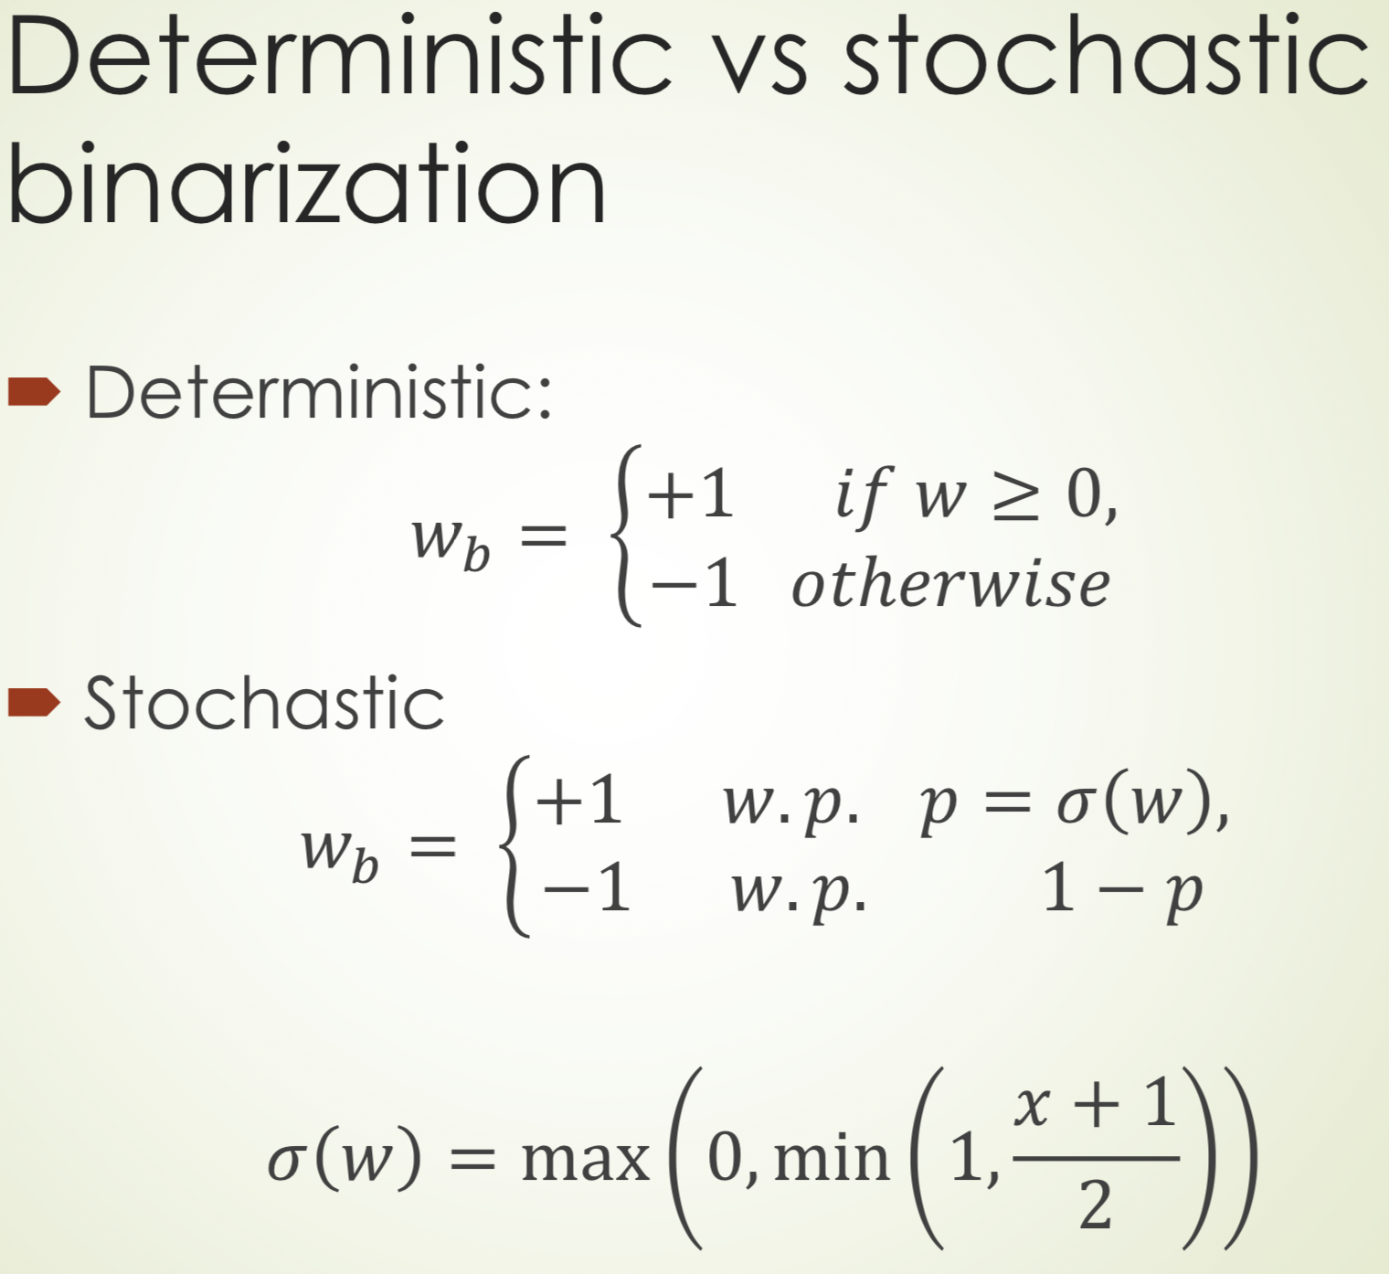
Binary-Connect
W = weights with full-precision
Wb weight with quantized weight
Only weights are binarized
σ(w) hard sigmoid
Weight Binarized for forward-propagation and backward-propagation but not for parameter update

Slide 56
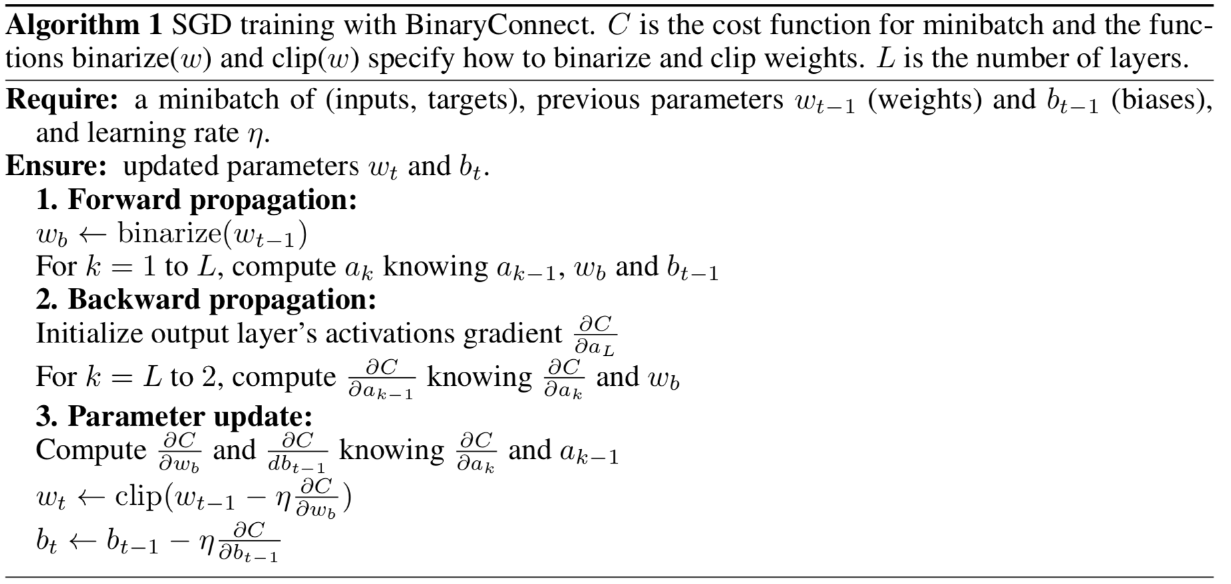
Binary Connect Algorithm

Slide 57
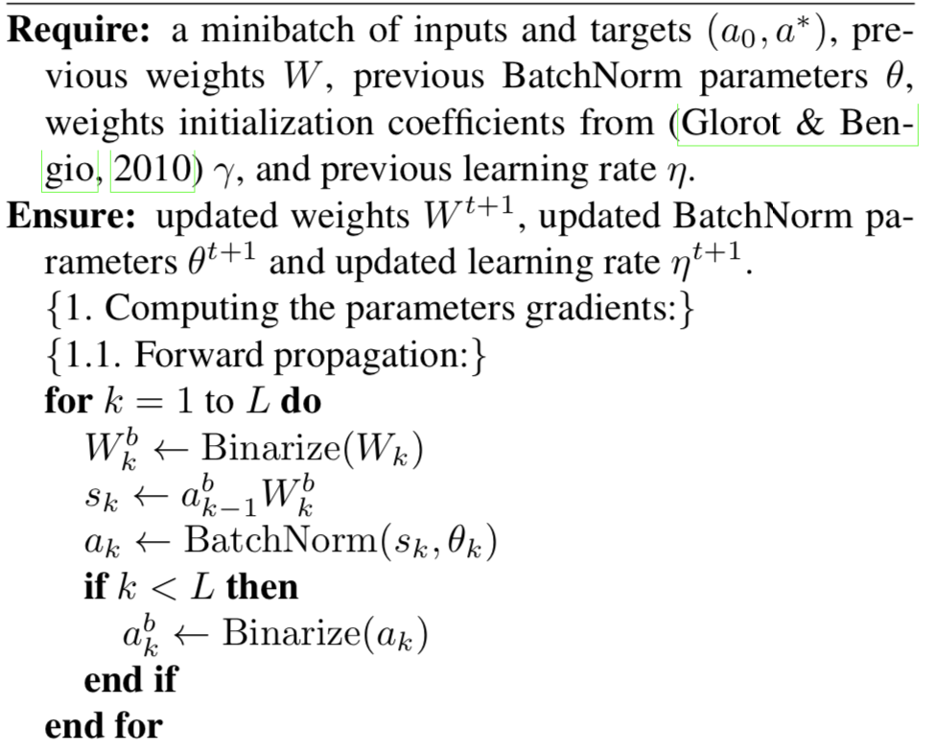
Binary Neural Network
Binary Connect with activations binarized too.

Slide 58
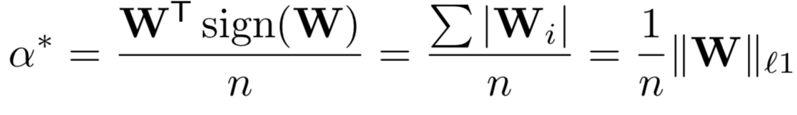
Binary Weight Network
This network uses same concepts as BinaryConnect
The way weights are binarized in different way.
W - real Valued Weights
I - real valued input tensor
* - Convolution operation
I * W ~ (I ± B)𝛂
B - Binary Weights (sign of W)
± Convolution with only addition/Subtraction
𝛂 - Real valued scalar factor (Average of W)

Slide 59
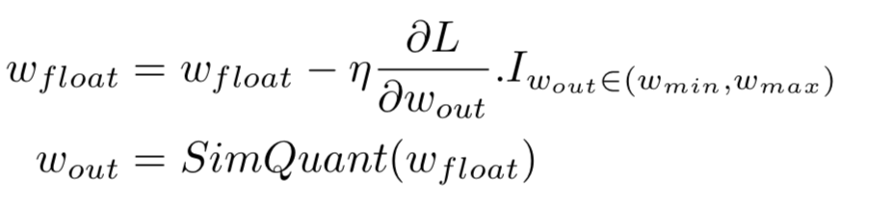
Our Approach
W_{float}
Quantize
W_{quantizedl}

Slide 60
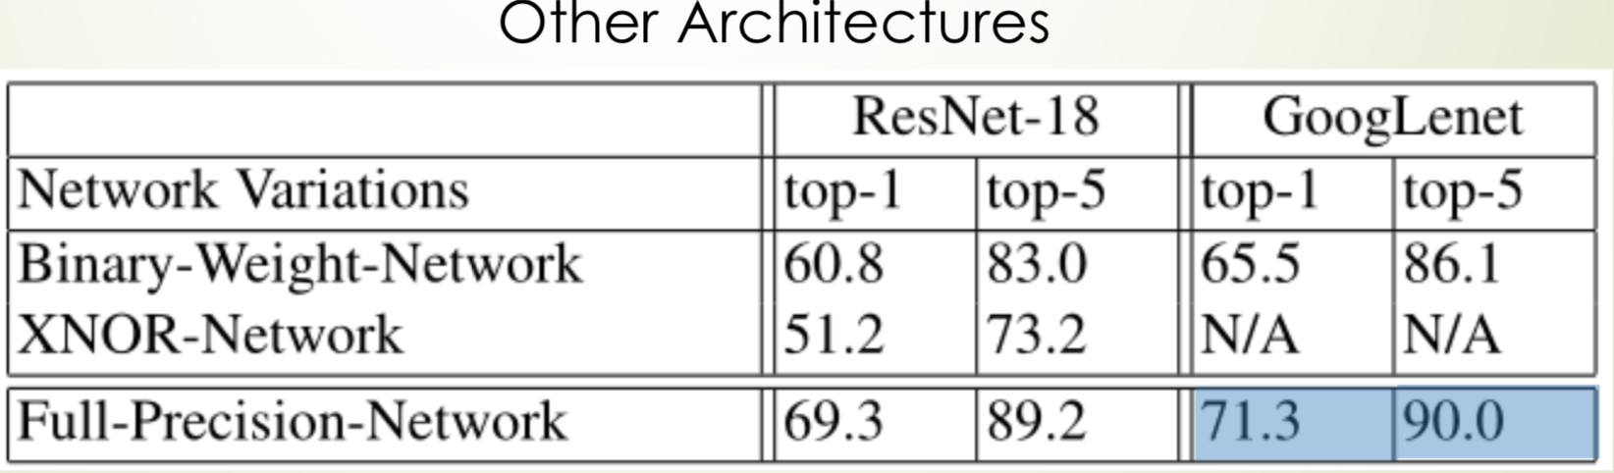
Results on other Architecture

